Slide 1
Proposal

Slide 2
Process
Overview 3
Game Introduction 4
Game Inspiration 5
Storyboard 6

Slide 3
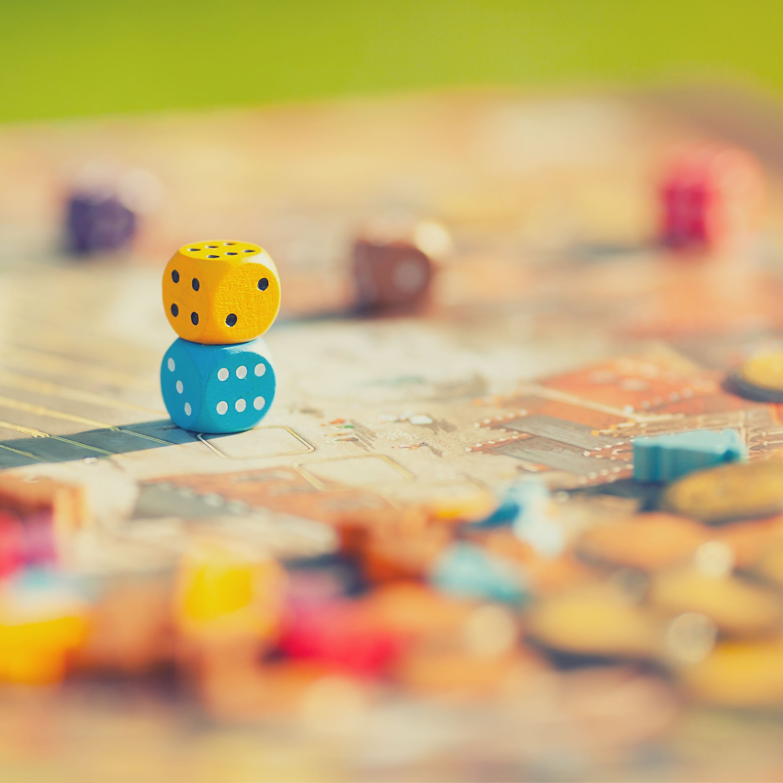
Overview
Object：Based on the classic Nokia Snake game, we wanted to create a Snake game with the same gameplay but with some new game mechanics.
Core gameplay： Players control the snake to move around the map, eat food to grow, avoid obstacles and their own snake body, to obtain a high score.

Slide 4

Game Introduction
Game title ：Gluttonous Snake
Game task:
The player must control the snake to eat the food that appears in the map, making the snake longer, while avoiding obstacles and the snake itself.

Slide 5

Game Inspiration
We referred to the classic snake gameplay, but considering that the classic snake is too simple, we added several new mechanisms, such as eating a good apple will score one point, and eating a bad apple will deduct one point, and some hostile units will be added to the map, and if the snake's head touches, it will die directly. Make the game more fun and challenging by integrating classic gameplay with new game mechanics.

Slide 6
Storyboard

Slide 7
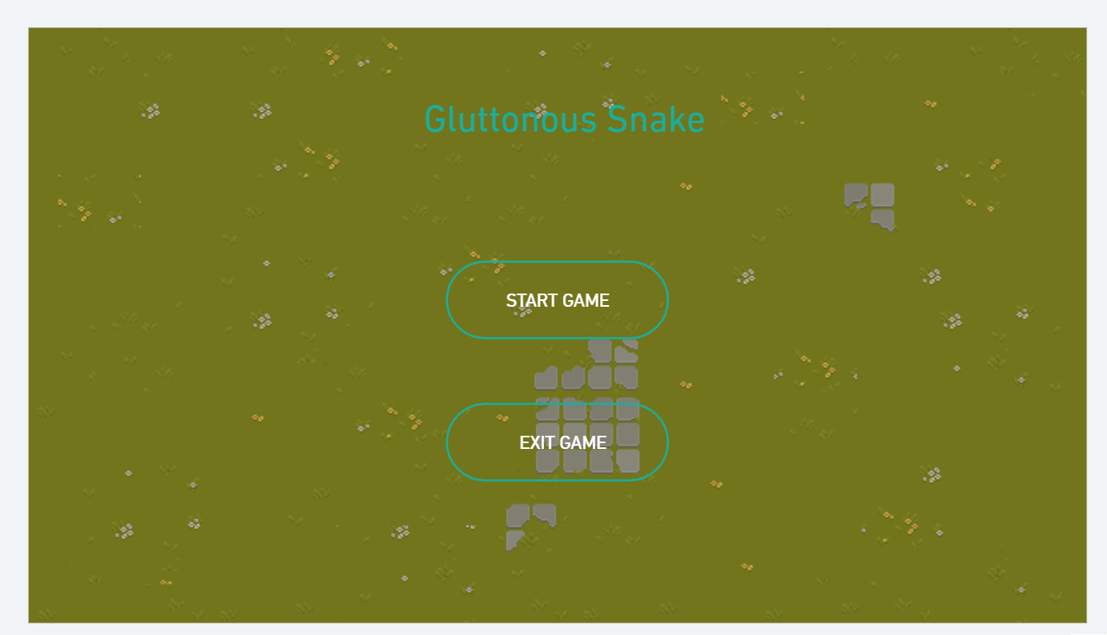
Main interface design
The interface contains two interoperable buttons, one to exit the game and one to start the game

Slide 8
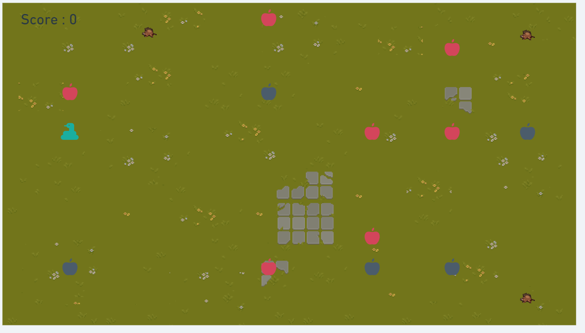
Game interface
We're going to use a two-dimensional array to create this map, which will have three objects, snakes, apples, and hostile units. Where you eat the red apple will get points, eat the black apple will deduct points, if your head hits the enemy units and map boundaries will directly end the game. As time goes by, the snake will get faster and bigger, which will cause you to die easily.

Slide 9
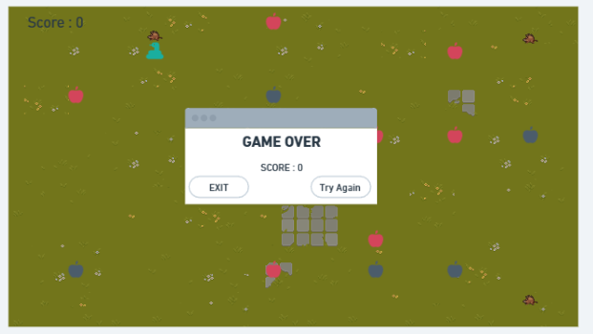
Settlement interface
A window will pop up at the end of the game, which will show you your score, at which point you can choose to quit or try again.

Slide 10
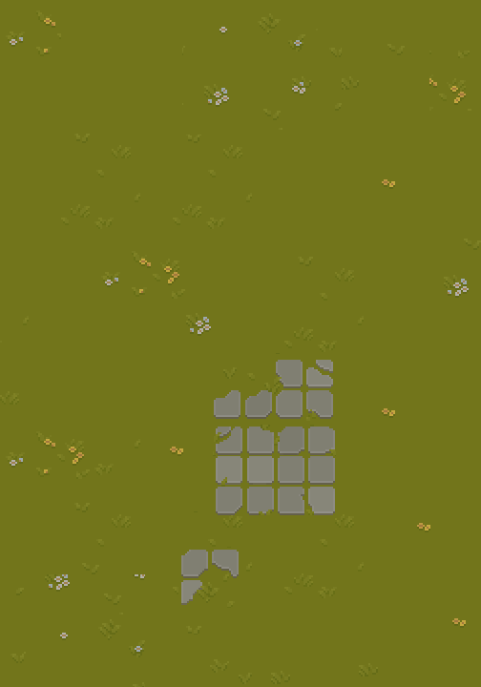

TKANK YOU

